Slide 1
EE 74099 / EN 74099 Research Project
Proposal Presentation For The Final Year Project
12.07.2019
Project title: Order Management System And Vision Based Autonomous Delivery Robot For Restaurants
Members:
ANFM. Begum, GSU. Ahmadh & IIS. Prema Sri
Supervised by : Dr. WGCW Kumara & Eng. MFM. Abdul Cader
Department of Electrical and Telecommunications Engineering
Faculty of Engineering
South Eastern University of Sri Lanka

Slide 2
Content
Introduction
Objective
Proposed methodology
Order Management system
External vision based navigation and path planning
Robot design and control
References

Slide 3
Introduction
Our project is mainly on having an external vision based navigation system for indoor robots.
As for the application of it, a restaurant delivery robot will be built and run on this system.
3 major sections of the project will be presented
Order Management System
Vision based navigation system
Robot build and control

Slide 4
Introduction
Customer reserves the table and order food on our system
Management receives order and when it is ready, mark the order as ready to collect
Navigation system gets the starting and destination locations and generating a path based on objects in the environment
Robot follows the path and delivers the food and if it encounters any obstacles, a request made for path regeneration and once the new path is received by the robot it reroutes it’s way along it
And finally, customer takes the food from the robot’s plate

Slide 5
System Diagram
User
User will put the order through the order management system.
Order will be notified to the chef and chef will place the food on the robot food-placeholder once the order is ready.
Order management system will send a message to the delivery robot to collect the food.
Navigation system will then navigate the robot to the destination table and the customer on the table will take the food.
PDA
External camera
Main Server
Delivery Robot
PC
Chef
Figure 1: System diagram

Slide 6
Objective
Having a navigation system for internal robots by directing it with an external vision based navigation system and applying the system for restaurant delivery robot

Slide 7
Proposed methodology
In order to achieve this, we are going to deal with our project into three parts as below,
Customer order management system
External vision based path planning
Robot’s hardware and control system

Slide 8
Order management system

Slide 9
Order Management System
User interaction can be given via handheld device at the table.
For the purpose for creating web application, we have to deal with a scripting language(PHP), a web server(Apache) and a database(MySQL). Now we are using XAMPP which is combined with X-OS (cross platform), Apache, MySQL and PHP.
Webpage mainly have two interface.
Customer’s interface can be used to ordering the food, table reservation and payment.
Admin’s interface can be used to order updates, food availability and give notification to the robot.

Slide 10
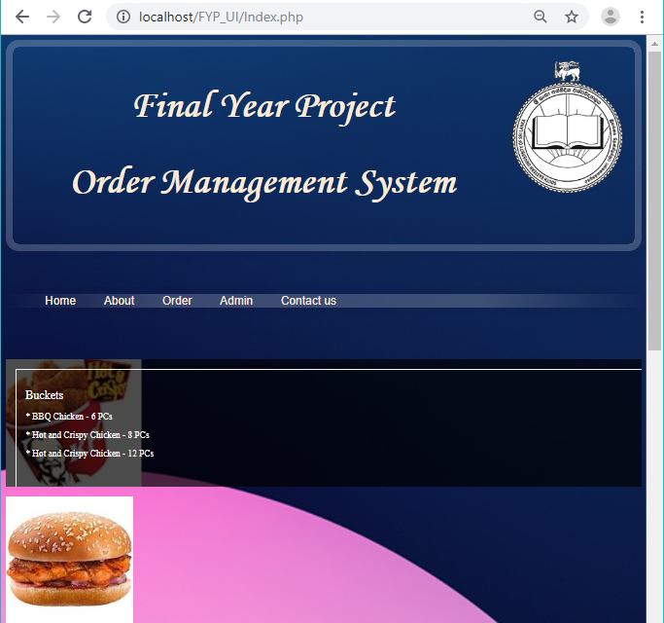
User can go for ordering page by tapping “Order” menu while admin can login through by tapping “Admin” menu.
Figure 3: Home page

Slide 11
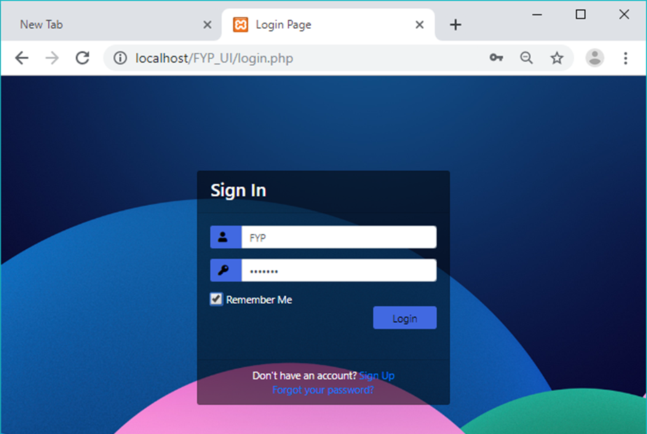
Admin can update their valid username and password in database. Hence no one can enter the admin page by login. If we enter the correct password server will check the details in database and it will allow to the admin page.
Login page decides who will be going to use the web application.
Figure 4: login window for enter to the administration page

Slide 12
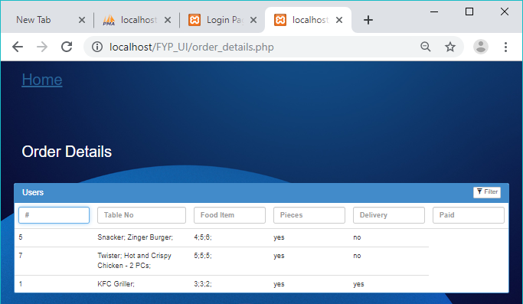
Admin should be responsible for updating the food availability and the order details in the database. Then it will be shown in customer’s ordering page.
Selected foods by customer can be send through the admin page by getting data from database.
Figure 5: food order list in the user window

Slide 13
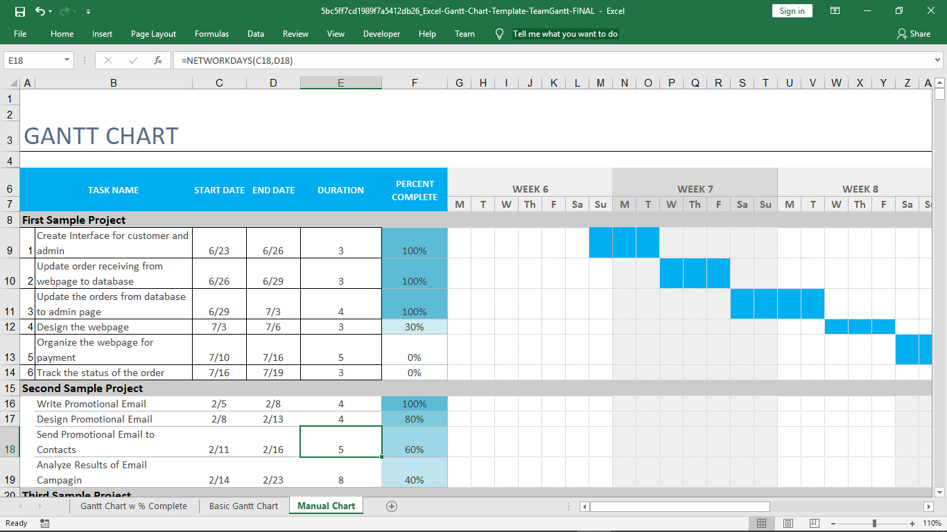
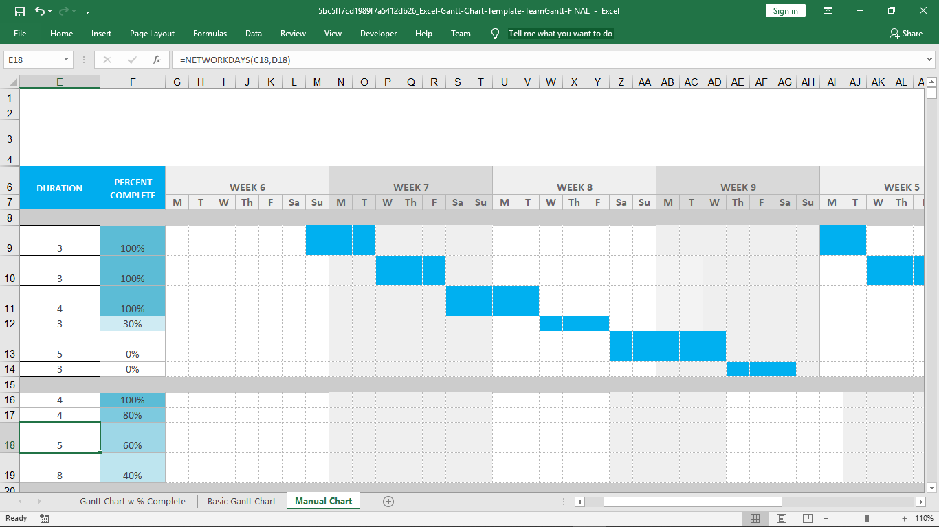
Gantt chart of OMS
Figure 5: Time line

Slide 14
EXTERNAL VISION BASED NAVIGATION AND PATH PLANNING
Notes:
Thanks Ms Mursina, And good morning everyone. I am Umair Ahmadh, dealing with the part of this project, the navigation system which is the main driving force of our goal. Let me get straight into the show.

Slide 15
Introduction and objectives
A centralized navigation system powered by computer vision
Path planning in an environment with dynamically changing objects
Notes:
Where I will be talking about existing systems, how our navigation system is going to be and what we have done so far.

Slide 16
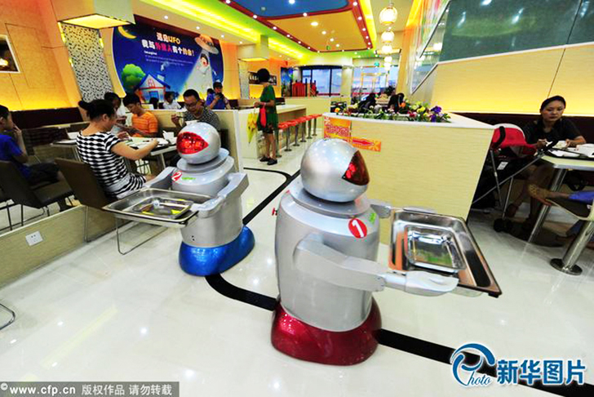
Existing systems
Fixed path following
burying an inductive loop or magnets in the floor
painting lines on the floor
placing beacons, markers, bar codes etc. in the environment.
Figure 6: Line following robots
Notes:
From the literature reviews we have found certain methods of navigation and for positioning of the robots in indoor environments. Summarizing them, leads me to mainly 5 of them. Among which the first is currently in practice for many robots and I will lsit down other possibilities of such systems and the reasone why don’t they stand out in the competition. First one is a simple line following method of navigation, where in the floor there are inductive and magnetic loops buried or recognizable lines drawn on the floor or else there are applications where there are markers on several points of the room to give the robot its location.

Slide 17
GPS
For outdoor, the GPS (Global Positioning System) provides a general solution for positioning.
However, the indoor positioning problem is still open.
Infrared
its short range
requiring a line of sight
Notes:
And moving on to other possibilities of robot navigation and localization, we have GPS which is a very general solution in the outdoor environment. Howeever in indoor environments a proper solution is having its distance from achieving it.
Moving on to the next solution, Infrared. As its very short range and its requirement of line of sight makes it in the list of not a good option.

Slide 18
Wi-Max
range of 50 km
Too large scope for indoor positioning
Bluetooth
Detecting Bluetooth signal strength and estimating their movement and location.
Requires many Bluetooth devices and fluctuates too much
Thus, it’s not a preferred way.
Notes:
The next solutions are WiMax ad Bluetooth. WiMax is having a very long range and thus it makes an suitable selection for an indoor environment. And the Bluetooth as it requires many Bluetooth devices for such a navigation system, it also makes it way harder to be the good solution for this purpose.

Slide 19
Vision based approach
Lastly, a more advanced way of navigation
Using cameras to navigate the robots
Cameras built in the robot get the surrounding view and objects in front
Notes:
Lastly, we have another, a bit advance solution which makes use of computer vision to get the robot navigated to the target position.

Slide 20
Our approach
Cameras on top of the room gives an overall view of the space
Detection of objects moving around and generating an obstacle map
Based on the current obstacle maps a path is generated from the starting point to the destination
Updating the path dynamically depending on the obstacles on the environment

Slide 21
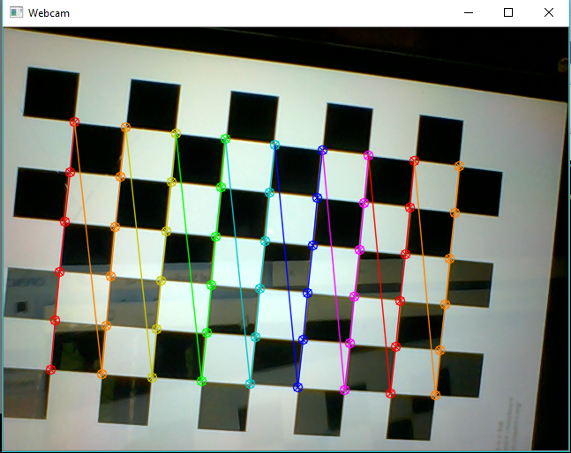
Camera Calibration
Current progress
Figure 5: Camera calibration using chess board

Slide 22
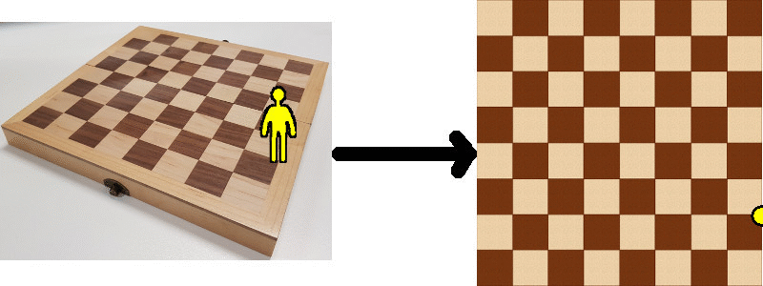
Transforming camera coordinates
into world coordinates
With the use of Homography, we were able to achieve the transformation of camera coordinates to real world coordinates.
Like in the following example,
Source: https://zbigatron.com/mapping-camera-coordinates-to-a-2d-floor-plan/
Figure 5: Transformation of camera coordinates to world coordinates

Slide 23
Path planning algorithm
As we are dealing with a dynamically changing environment, path planning algorithms like Dijkstra are more likely to be ineffective as they require predefined nodes
Algorithms based on Rapidly exploring random tree (RRT), will be the effective choice for our purpose

Slide 24
Path planning algorithm
Obstacle map generated with the external cameras will be fed through the algorithm to generate a path
When a sudden object come across the path, sensors on the robot detects and stop the movement. A path regeneration is requested to the system and the robot rerouted with the new path

Slide 25
Robot Design and Control

Slide 26
Defining requirements of the robot
To design the body and select components accordingly, first we need to identify the design requirements
The robot should be able to move and supply food to any table avoiding obstacles.
Design should be able to hold electronics components such as microcontrollers, sensors and battery.
The maximum payload robot should be able to carry .
Ground clearance of the robot.
Robot height.
Robot should be of low cost.
One of the easiest designs to satisfy these requirements is TurtleBot, which has a design similar to table design.

Slide 27
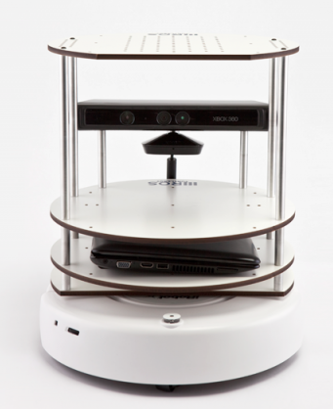
Robot chassis design
It has three layers in the chassis.
The design of our robot will be similar to this with our own moving platform and components.
Moving platform will be designed as a differential drive system.
Source - www.willowgarage.com

Slide 28
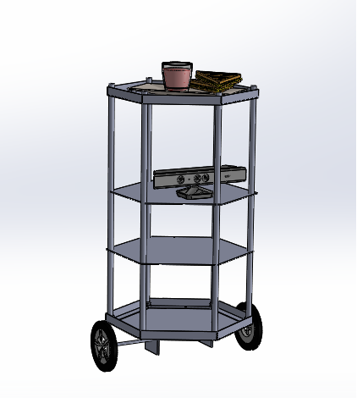
Designing Robot model
We did a 3D model for the Robot design we are planning to build.
For the plates we decided to go with Aluminum Composite Material boards because of their strength and light weight.
To connect plates we will be using threaded rods covered by aluminum tubes.

Slide 29
Designing Robot model
A rough design of the proposed robot

Slide 30
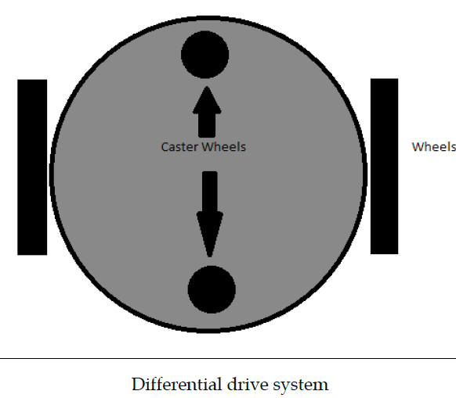
The choice of wheel types for a mobile robot is strongly linked to the choice of wheel arrangement, or wheel geometry.
One of the cost-effective solution for mobile robot navigation is differential drive systems^{[2]}.
Source : www.semanticscholar.org

Slide 31
Current progress
Design and weight analysis
Motor torque estimation
Materials and component selection
Building the robot

Slide 32
Estimation of the robot weight
Item | Weight
ACM Board for 0.378 𝑚² area | 1.52 𝑘𝑔
Threaded rods for 3.5 m | 2.2 kg
Kinect | 0.6 kg
Aluminum tubes | 0.4 kg
Wheels | 0.6 kg
Power Bank and Battery | 1.0 kg
Motors (NEMA 23) x 2 | 1.2 kg
Other Electronics | 0.5 kg
For foods | 1.0 kg
Steel Bottom plate | 0.8 kg
Total Weight | 9.83 kg

Slide 33
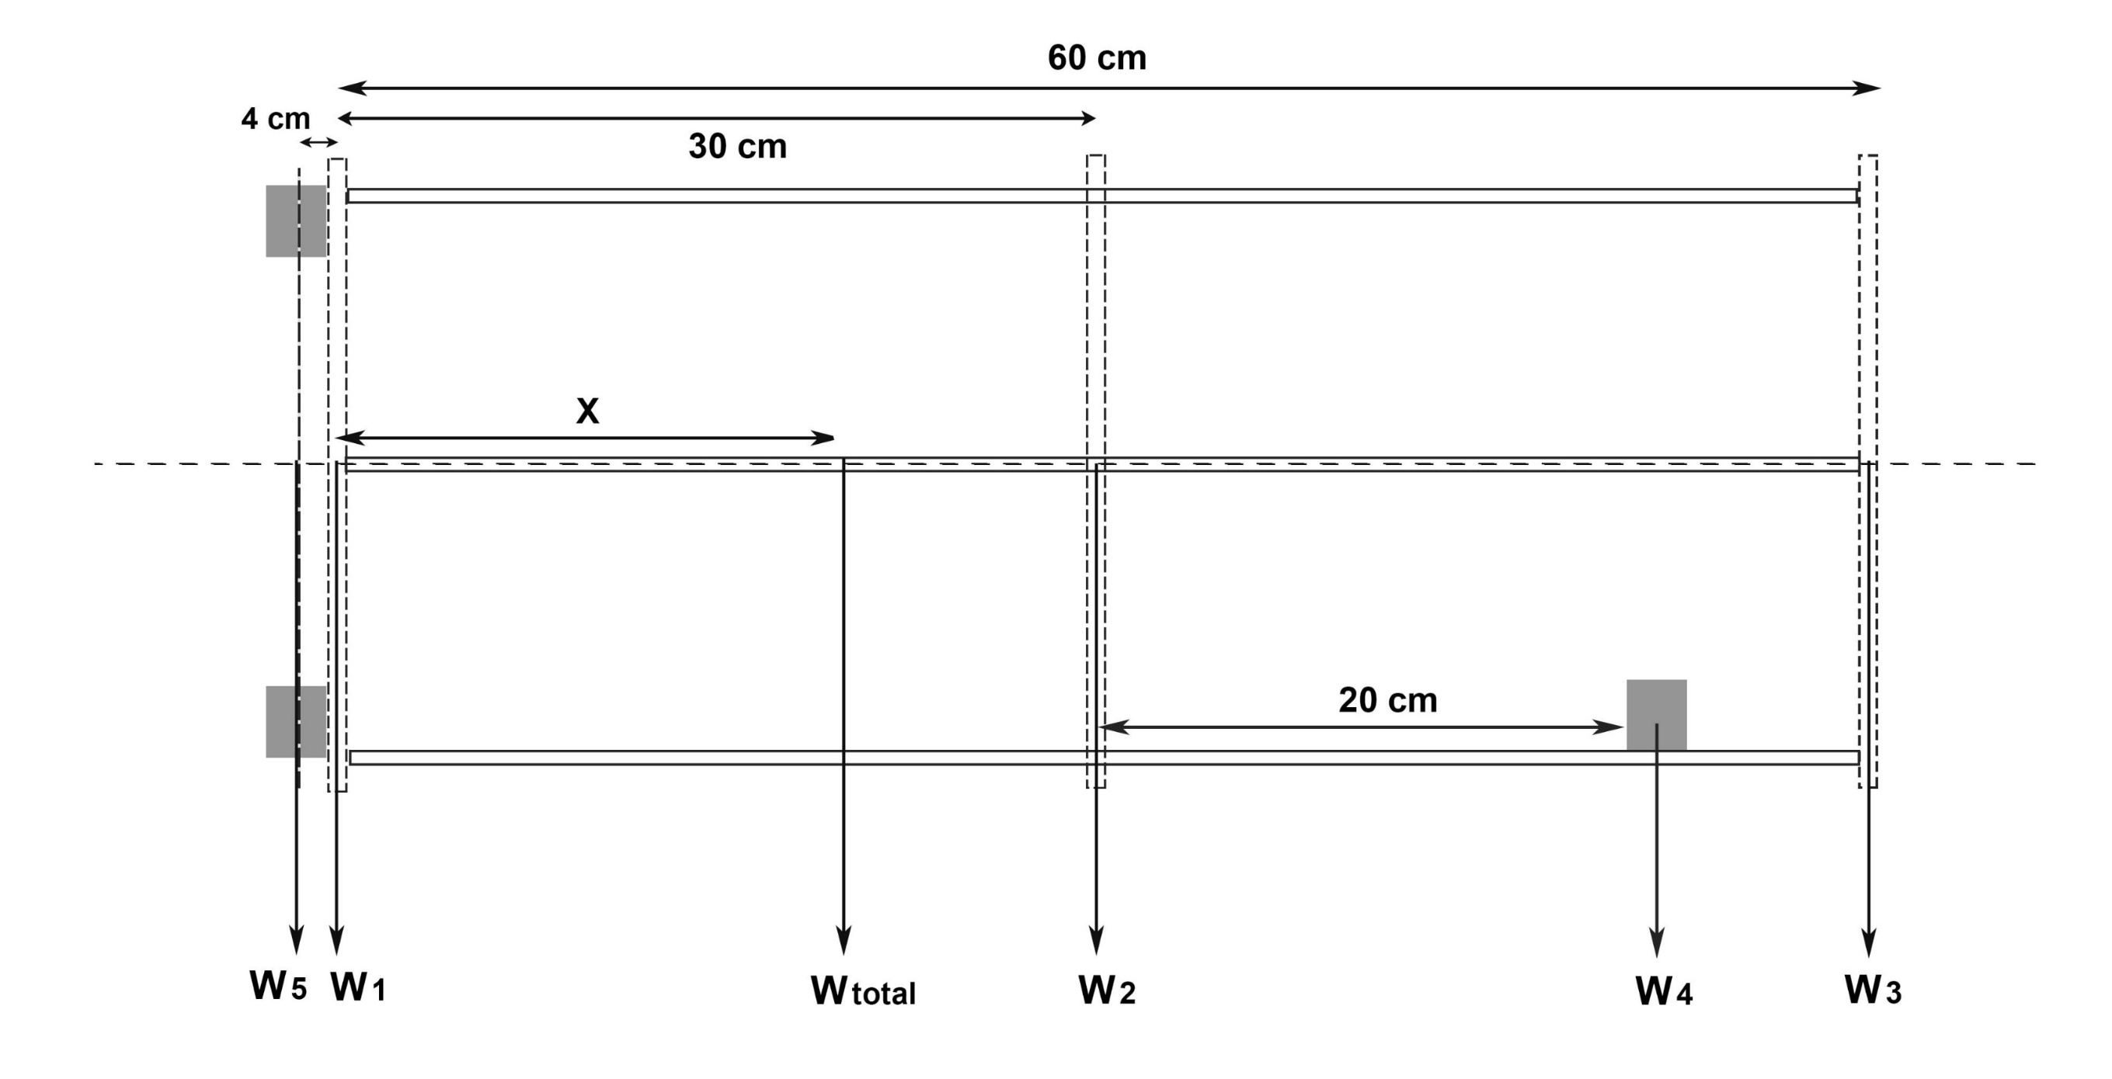
Estimation Center of Gravity
P
Based on weight estimation, we did a canter of gravity calculation for the design.
According to the calculation the Center of Gravity of the robot design is 0.235 m above the bottom plate.
It is 9.1cm below the center.

Slide 34
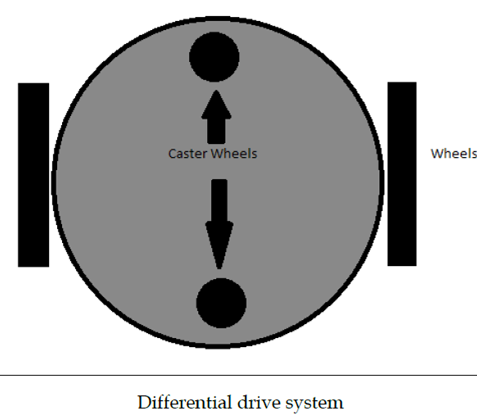
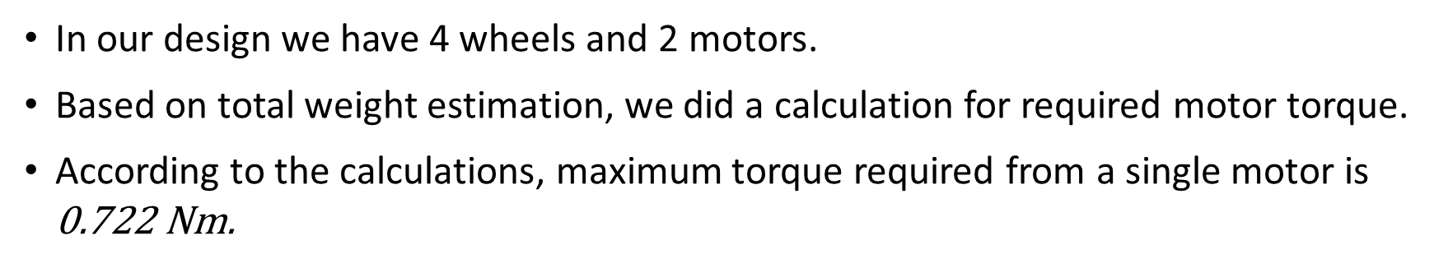
Estimation of required motor torque
In our design we have 4 wheels and 2 motors.
Based on total weight estimation, we did a calculation for required motor torque.
According to the calculations, maximum torque required from a single motor is $\text{0.722 }\text{N}$m.

Slide 35
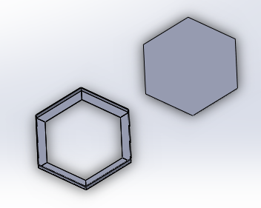
Selection of material and components
Bottom plate and L profile – Steel
Bottom plate should have strength to connect
motors and wheels.

Slide 36
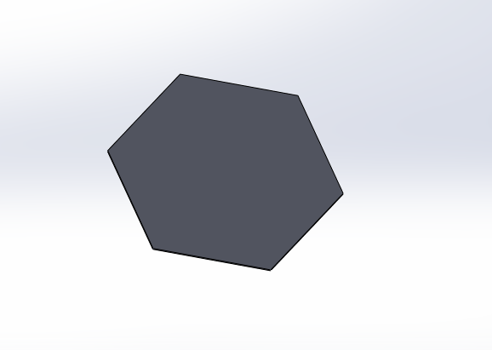
Selection of material and components
Middle and top plates – ACM (Aluminum Composite Material )
The material selected should have strength and
also it should be light weight.

Slide 37
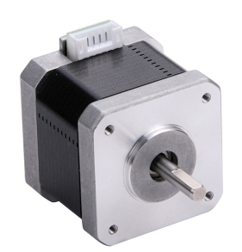
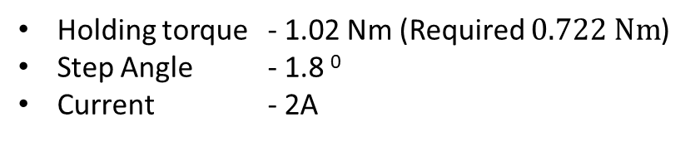
Selection of material and components
Motor – NEMA 17 Stepper Motor
Holding torque - 1.02 Nm (Required $\text{0.722 }\text{Nm}$)
Step Angle - 1.8 ⁰
Current - 2A

Slide 38
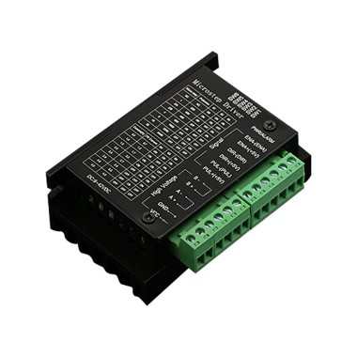
Selection of material and components
Motor Driver – TB6600 Stepper Motor Driver
Output Current - up to 4.0A
Micro Step - 1, 2/A, 2/B, 4, 8, 16,32

Slide 39
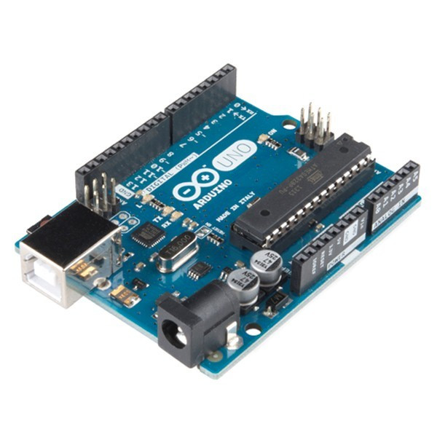
Selection of material and components
Microcontroller for driving motor – Arduino Uno
Digital I/O Pins - 14
Operating Voltage - 5V

Slide 40
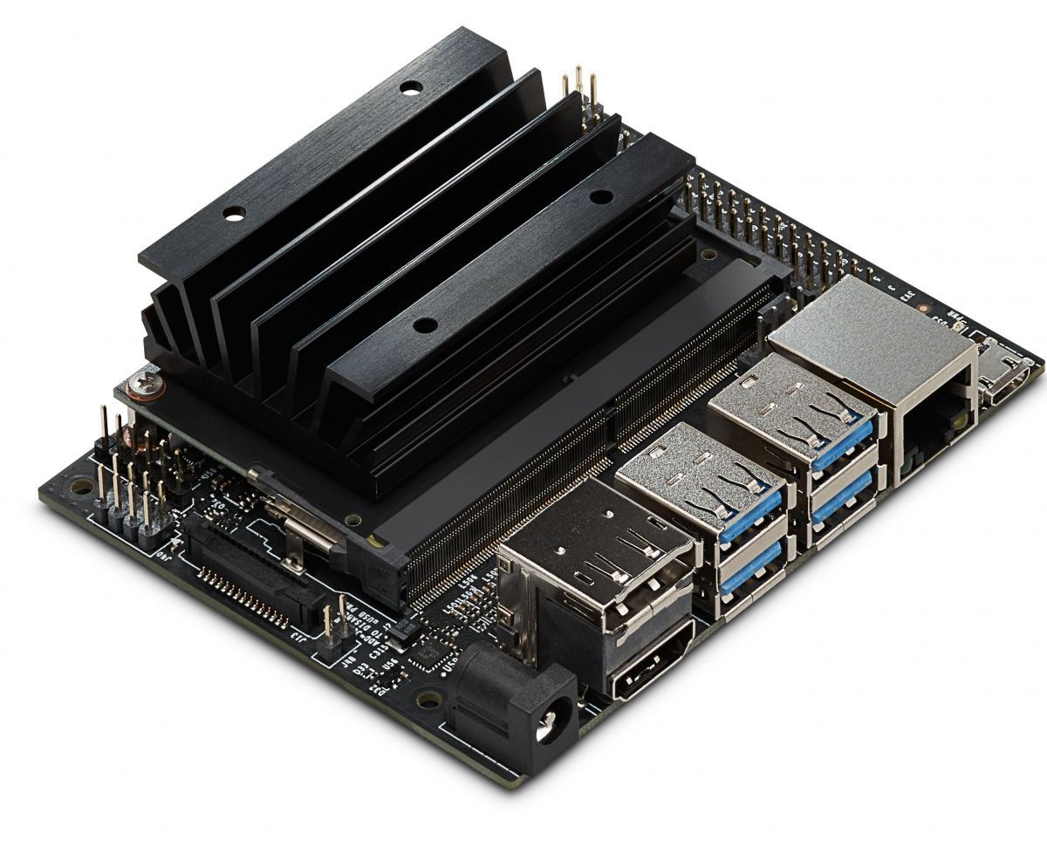
Selection of material and components
Main computer - Nvidia Jetson Nano
Quad-core Arm A57 processor @ 1.43 Ghz
4GB System Memory
4 x USB 3.0 ports, 1x USB 2.0 Micro-B port for power

Slide 41
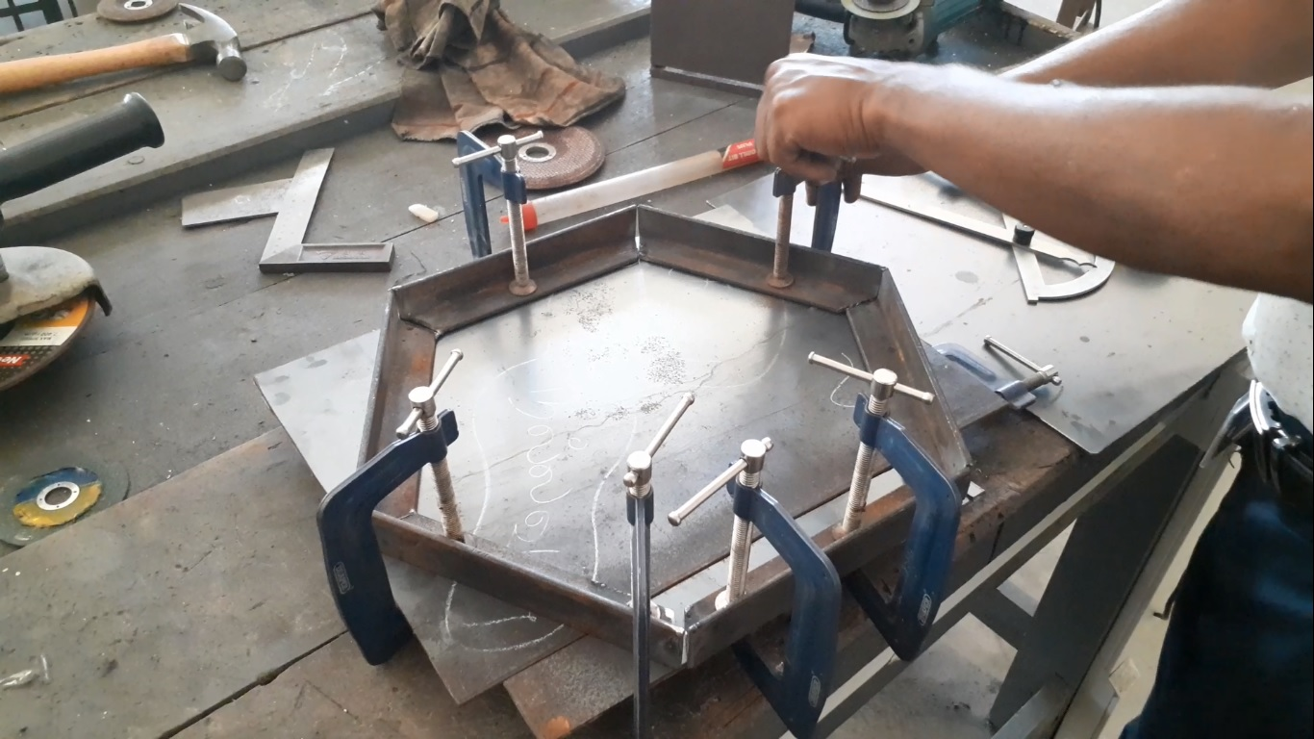
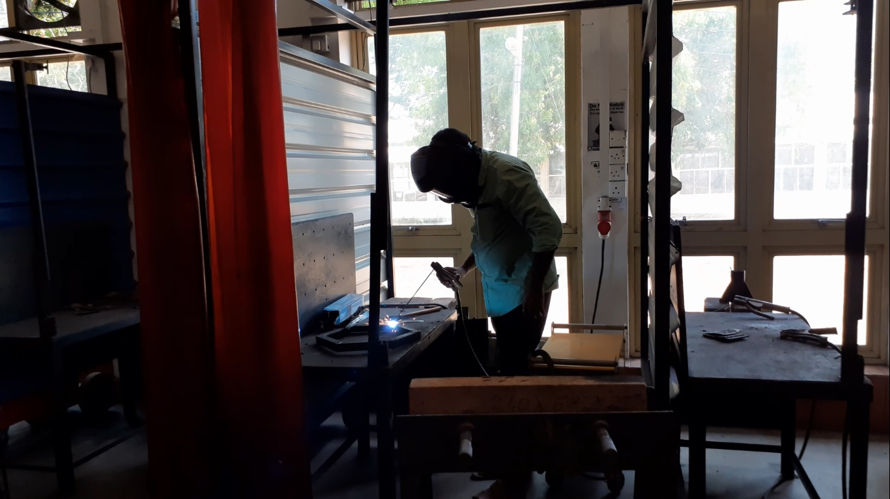
Building the robot

Slide 42
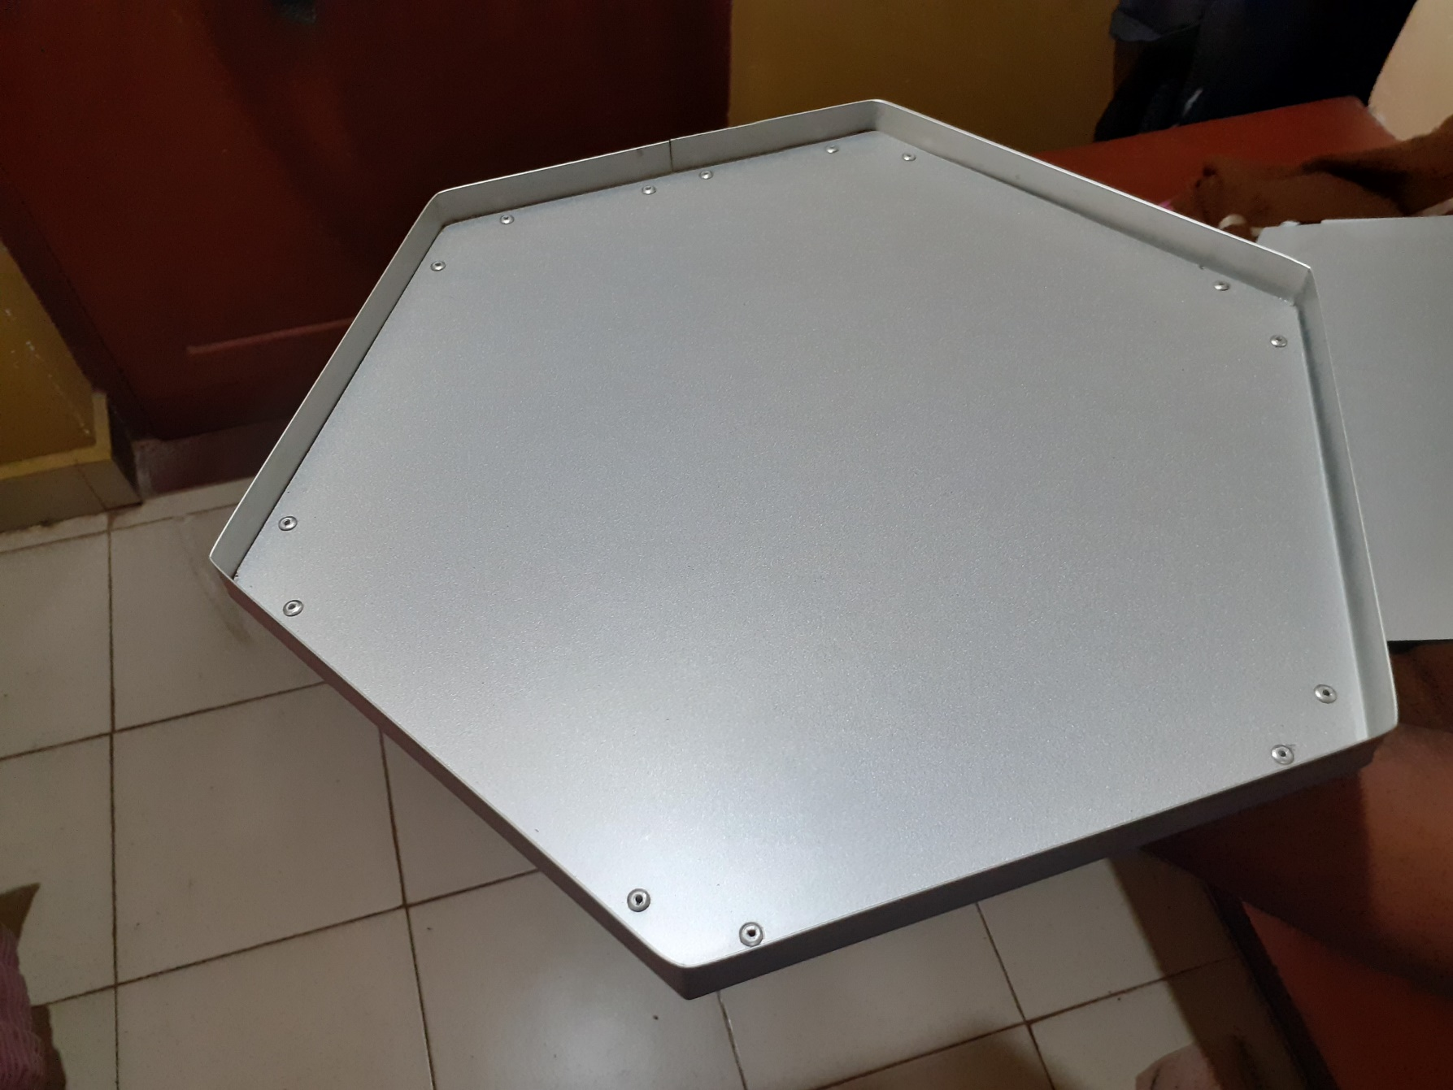
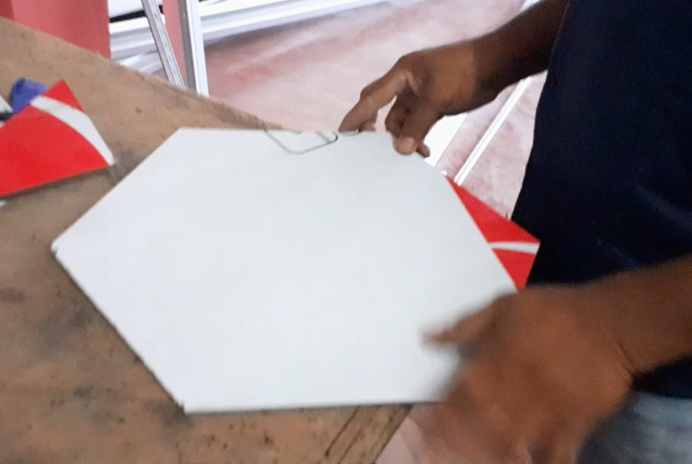
Building the robot

Slide 43
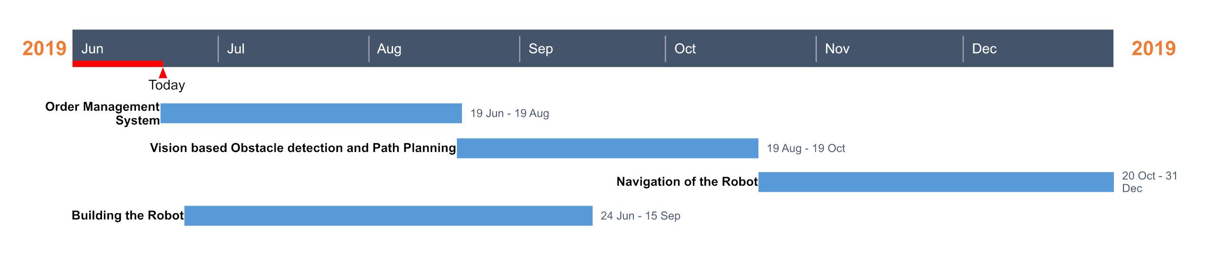
Timeline
Figure 2: Timeline in a Gantt chart

Slide 44
References
[1] Advanced Science and Technology Letters Vol.112 (Architecture and Civil Engineering 2015), pp.46-49 - Jaegeol Yim
[2] Joseph, L. (2015). Learning Robotics using Python. PACKT.
[3] Siegwart, R., Nourbakhsh, I. R., & Scaramuzza, D. (2011). Introduction to autonomous mobile robots. MIT press.

Slide 45
Thank You

Slide 46
Appendix

Slide 47
Calculation of motor torque
In our design we have 4 wheels and 2 motors.
Here we assume that the coefficient of friction is 0.6 and radius of wheel is 5 cm.
The weight acting on the four wheels can be written as,
N1 is the weight acting on each caster wheel.
N2 on each motor wheel.
$$\text{2 ∗ }\text{N}\text{1 + 2 ∗ }\text{N}\text{2 = }\text{Total} \text{Weight}$$
The maximum torque is required when the robot starts moving. It should also overcome friction.
To calculate the maximum torque (T),
$$\text{μ}\text{ ∗ }\text{N}\text{ ∗ }\text{r}\text{ − }\text{T}\text{ = 0}$$
μ is the coefficient of friction.
N is the average weight acting on each wheel.
r is the radius of wheels.
T is the torque.

Slide 48
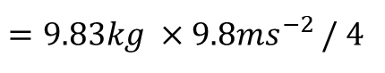
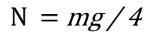
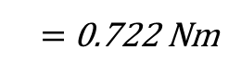
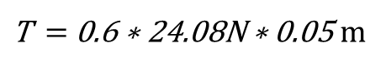
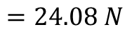
Calculation of motor torque
Assuming that the weight of the robot is equally distributed on all the four wheels,
$$\text{N} \text{=} \text{mg}\text{ / 4}$$
$=9.83kg ×9.8{ms}^{−2}$ / 4
$$=24.08 N$$
Motor torque required,
$\text{T} \text{=} \text{0.6 ∗} \text{24.08}\text{N}\text{ ∗ 0.05}$ m
$\text{=} \text{0.}\text{722 }\text{N}$m
Reference - Learning Robotics using Python by Lentin Joseph

Slide 49
Center of Gravity Calculation
P
Based on weight estimation, we did a canter of gravity calculation for the design.
According to the calculation the Center of Gravity of the robot design is 0.235 m above the bottom plate.
It is 9.1cm below the center.

Slide 50

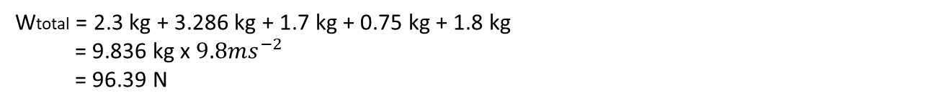
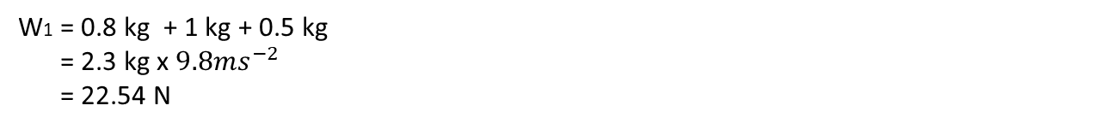
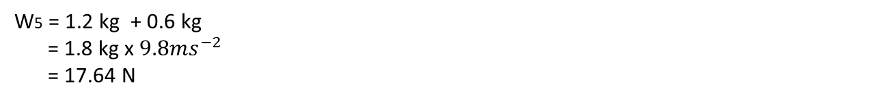
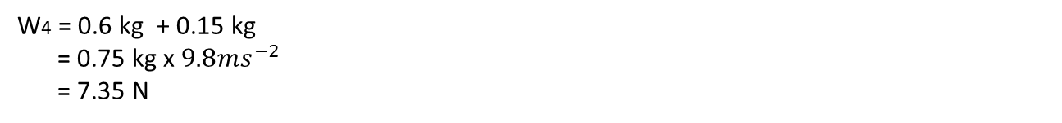
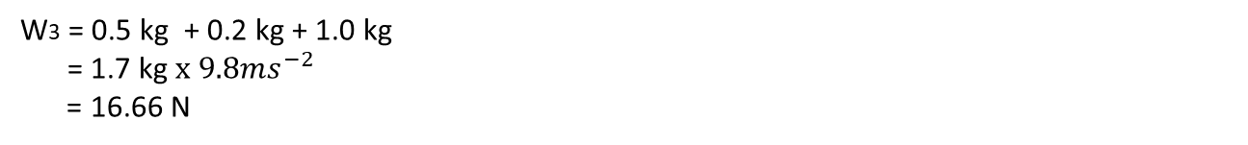
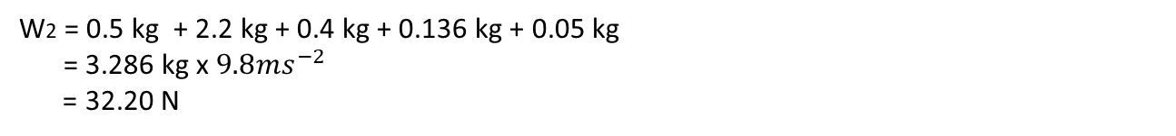
W1 = 0.8 kg + 1 kg + 0.5 kg
= 2.3 kg x $9.8{ms}^{−2}$
= 22.54 N
W2 = 0.5 kg + 2.2 kg + 0.4 kg + 0.136 kg + 0.05 kg
= 3.286 kg x $9.8{ms}^{−2}$
= 32.20 N
W3 = 0.5 kg + 0.2 kg + 1.0 kg
= 1.7 kg $x 9.8{ms}^{−2}$
= 16.66 N
W4 = 0.6 kg + 0.15 kg
= 0.75 kg x $9.8{ms}^{−2}$
= 7.35 N
W5 = 1.2 kg + 0.6 kg
= 1.8 kg x $9.8{ms}^{−2}$
= 17.64 N
Wtotal = 2.3 kg + 3.286 kg + 1.7 kg + 0.75 kg + 1.8 kg
= 9.836 kg x $9.8{ms}^{−2}$
= 96.39 N

Slide 51

P
Considering the moments around point P in clockwise direction,
W1 x 0 + W2 x 0.3 m + W3 x 0.6 m + W4 x 0.5 m - W5 x 0.04m = Wtotal x X
22.54 N x 0 + 32.20 N x 0.3 m + 16.66 N x 0.6 m + 7.35 N x 0.5 m - 17.64 N x 0.04m = 96.39 N x X
9.66 Nm + 9.996 Nm + 3.675 Nm – 0.7 Nm = 96.39 N x X

Slide 52
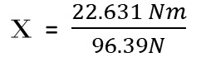
$\text{X}$ = $\frac{22.631 Nm}{96.39N}$
X = 0.235 m
According to the calculation the Center of Gravity of the robot design is 0.235 m above the bottom plate. It is 9.1cm below the center.

